Slide 1
Processes and Technology Major types of processes, assembly lines and other types of layouts (product, process, fixed-position).
BUSI 104 – Operations Management
Professor Ed Arnheiter

Slide 2
Major Process Types
Job Shops
(One type of Project process)
Batch
Continuous Production
Mass Production (Assembly Lines)

Slide 3
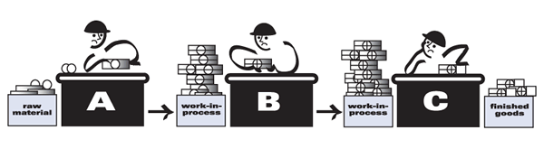
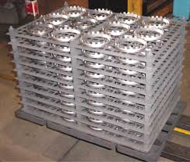
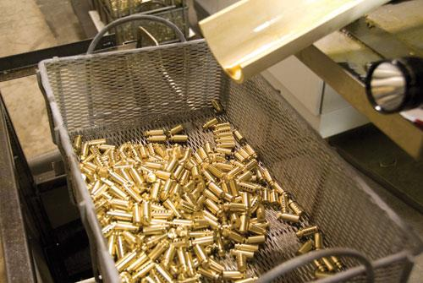
Batch Production

Slide 4
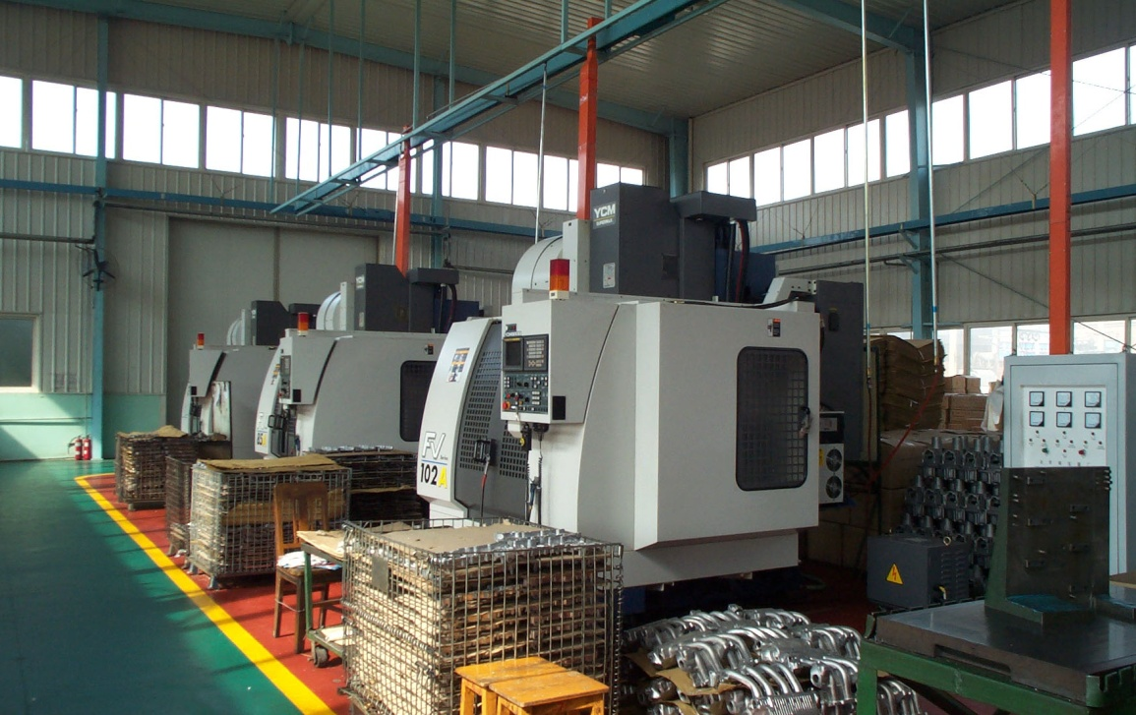
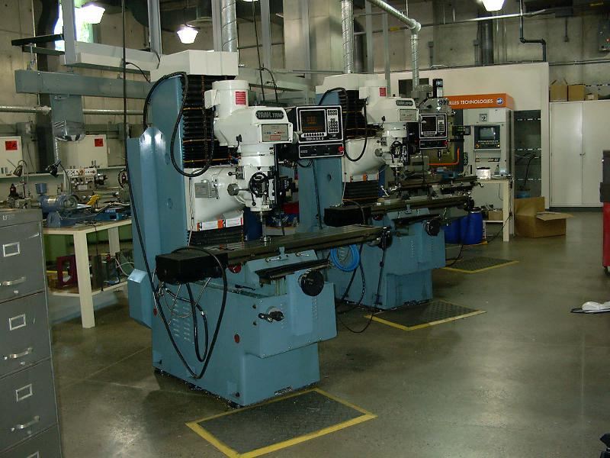
Job Shop Examples
Machines grouped by type
Low volume, high flexibility

Slide 5
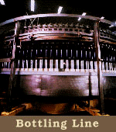
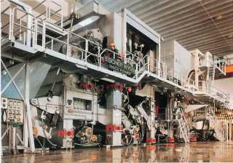
Continuous Production (a.k.a. continuous flow)
Paper Making

Slide 6
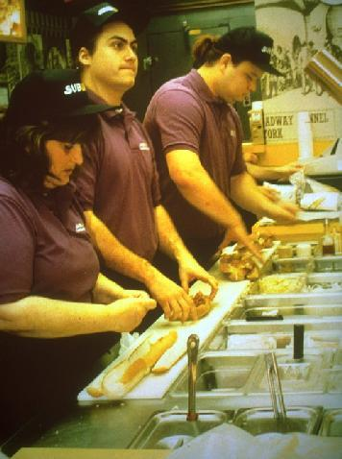
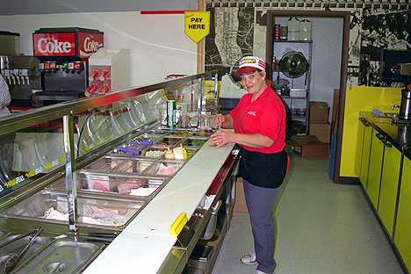
Worker-paced Assembly Line Subway Store

Slide 7
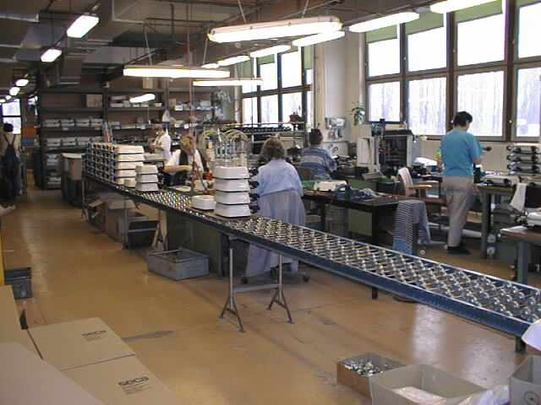
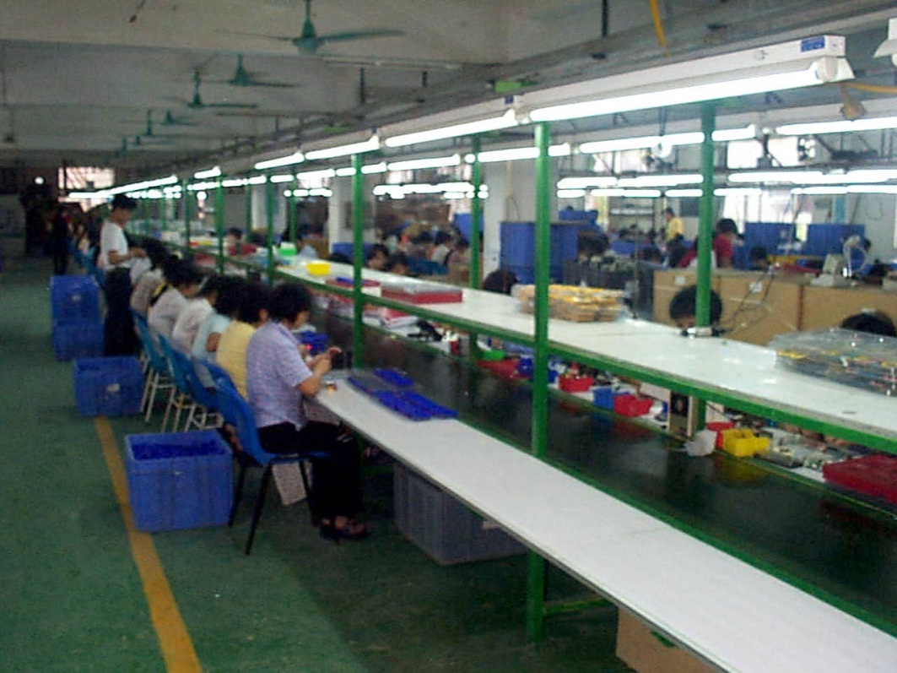
Worker-paced Assembly Lines
Parts move based on required operator pace

Slide 8
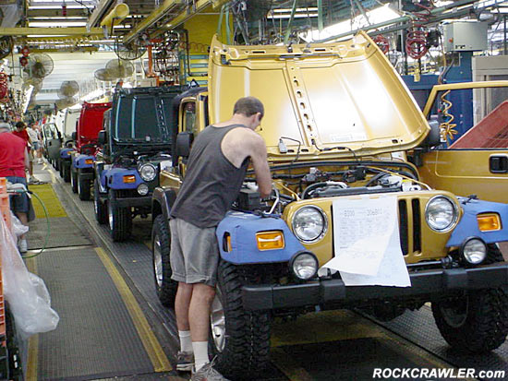
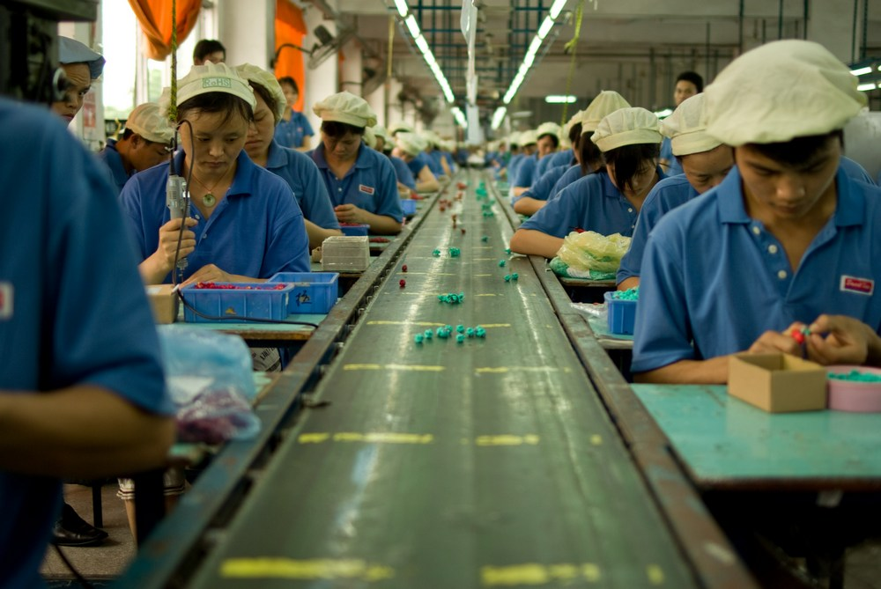
Equipment-paced Assembly Line
Less common than batch production, but have been studied in great detail.
Parts flow on belt or chain that maintains constant speed

Slide 9
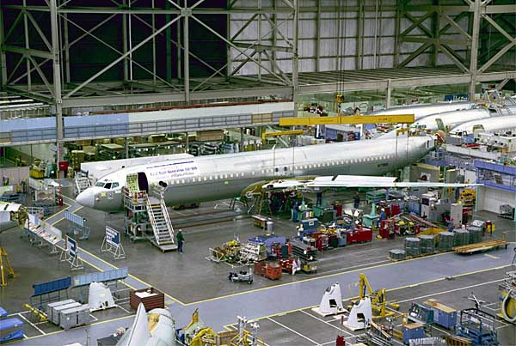
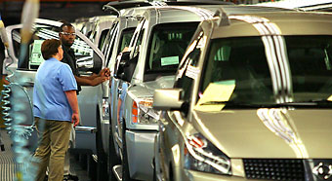
General Types of Production Layouts
1. Fixed Position
2. Product Layouts
Machines & resources arranged according to sequence of operations
Spoke and hub arrangement

Slide 10
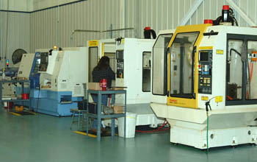
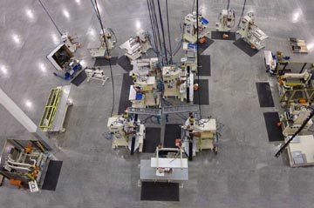
General Types of Production Layouts (continued)
4. Group Technology (GT) or Cellular Layouts
3. Process Layouts
Group machines with similar function or capability (e.g., Job Shop
Group parts into families based on similarities in function, materials, or processes (U-shaped Cell is common example).

Slide 11
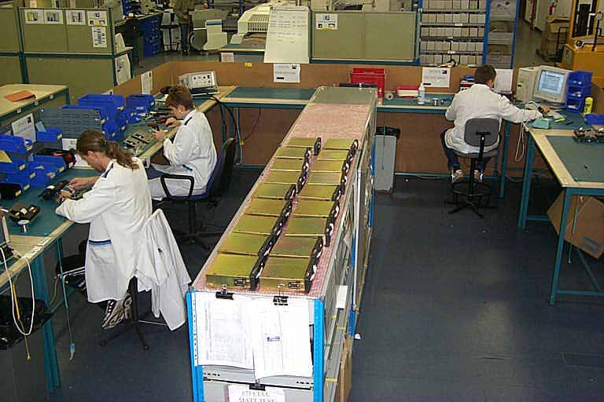
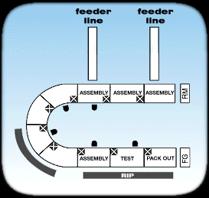
Cellular Layouts Essential Piece of Lean Production

Slide 12
Selecting the Production System
Continuous
Flow
20,000
2,000
200
20
Increasing flexibility
JIT
Volume
Increasing capacity
Low Medium High
Flexible
manufacturing
system
Mfg.
cell
Job shop
Batch
1 or 2 10 100 1000
Low Medium High
Variety

Slide 13
Summary of Traditional Production Systems
System |  | Products | Volume | Layout | Flow
Job shop |  | Very many products | One or a few of each | Functional | Extremely Varied
Batch Production |  | Many products | Low to medium volumes | Combination of functional and cellular | Varied with patterns
 | Worker-paced Assembly | Several to many | Medium volumes | Line layout | Mostly regular, paced by operators
 | Equipment-paced Assembly | Several products | High | Line layout | Regular, paced by equipment
Continuous Production |  | One or a few products | Very high | Line layout | Rigid, continuous
“Mass Production”

Slide 14
Characteristics of Four Traditional Systems
System | Characteristics | Other Names
Job shop | Operators work in one department only and are highly skilled. Equipment and tooling are general purpose. | Project
Batch production | Most items follow same flow pattern through plant. | Batch, standardized job shop
Worker-paced Assembly line | Line is more flexible than equipment-paced line and cane be run at variety of speeds. | Flow line, mass production
Equipment-paced Assembly line | Used when product design is stable and volume is high. Capital intensive and extremely specialized. | Paced assembly line, mass production
Continuous production | Most similar to equipment-paced line flow system. Produces standard product at lowest possible cost. | Continuous flow

Slide 15
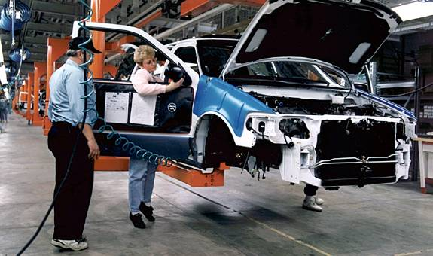
Automotive Assembly Productivity Metric
Hours Per Vehicle (HPV): Actual hours and actual production (direct, indirect, salary, and normal daily total absenteeism)
Adjusts for:
New launch programs
More or less vertically integrated operations (outsourcing)

Slide 16
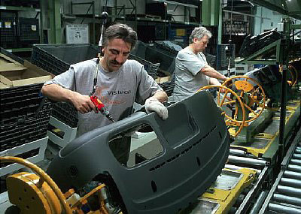
Outsourcing will Affect HPV
Assembly Line for Ford instrument Panels at Visteon Plant

